Slide 1
Knowledge Management

Slide 2
Concepts and Definition
Knowledge management (KM) is a process that helps organizations manipulate important knowledge that is part of the organization’s memory, usually in an unstructured format.
can be exchanged among persons
must be able to grow

Slide 3
What is Data & information?
Data comprises facts, observations, or perceptions
Data represents raw numbers
Information is processed data
Information is a subset of data, only including those data that possess context, relevance and purpose
Information involves manipulation of raw data

Slide 4
What is Knowledge?
A justified true belief
It is different from data & information
Knowledge is at the highest level in a hierarchy with information at the middle level, and data to be at the lowest level
Information with direction

Slide 5
Knowledge
Knowledge is information that is contextual, relevant, and actionable.
Information in action
Intellectual capital or intellectual assets

Slide 6
Data, Information, and Knowledge
Knowledge
Value
Zero
Low
Medium
High
Very High
Data
Information

Slide 7
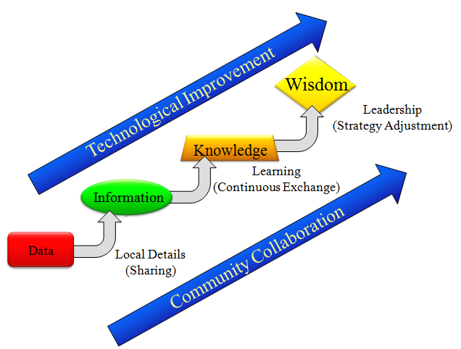

Slide 8
Data, Information, and Knowledge:Example
Knowledge
Counting
p_{H} = n_{H}/(n_{H}+n_{T})
p_{T} = n_{T}/(n_{H}+n_{T})
EV=p_{H} R_{H}+ p_{T} R_{T}
H T H T T
H H H T H
…
T T T H T
n_{H} = 40
n_{T} = 60
p_{H} = 0.40
p_{T} = 0.60
R_{H} = +$10
R_{T} = -$8
EV = -$0.80
Data
Information
Value
Zero
Low
Medium
High
Very High

Slide 9
Data, Information, Knowledge and Events
Knowledge
Data
Information
System
Information
Knowledge
Use of
information
Decision
Events

Slide 10
Subjective View of knowledge
Knowledge as State of Mind
Knowledge as Practice

Slide 11
Objective View of knowledge
Knowledge as Objects
Knowledge as Access to Information
Knowledge as Capability

Slide 12
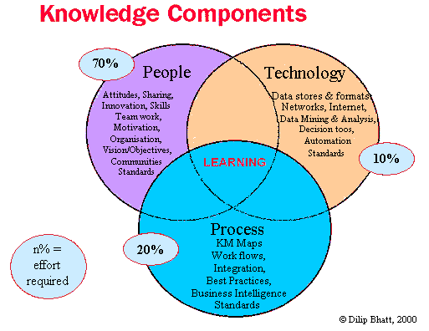
Knowledge Component

Slide 13
Types of Knowledge
Individual, social, causal, conditional, relational and pragmatic
Embodied, encoded and procedural

Slide 14
Procedural and Declarative Knowledge
Declarative knowledge (substantive knowledge) focuses on beliefs about relationships among variables
Procedural knowledge focuses on beliefs relating sequences of steps or actions to desired (or undesired) outcomes

Slide 15
Explicit knowledge
is the knowledge that has been codiﬁed (documented) in a form that can be distributed to others or transformed into a process or strategy.
deals with more objective, rational, and technical knowledge
consists of the policies, procedural guides, reports, products, strategies, goals, core competencies of the enterprise, and the IT infrastructure.

Slide 16
Tacit Knowledge
is the cumulative store of subjective or experiential learning.
Tacit knowledge consists of :
an organization’s experiences, insights, expertise, know-how, trade secrets, skill sets, understanding, and learning.
includes the organizational culture, which reﬂects the past and present experiences of the organization’s people and processes, as well as the prevailing values.
Tacit knowledge is generally slow, imprecise, and costly to transfer.
It is also highly personal.
Finally, because it is unstructured, it is difﬁcult to formalize or codify.

Slide 17
General and Specific Knowledge
General knowledge is possessed by a large number of individuals and can be transferred easily across individuals
Specific knowledge, or “idiosyncratic knowledge,” is possessed by a very limited number of individuals, and is expensive to transfer

Slide 18
Technically and Contextually Specific Knowledge
Technically specific knowledge is deep knowledge about a specific area
Contextually specific knowledge knowledge refers to the knowledge of particular circumstances of time and place in which work is to be performed

Slide 19
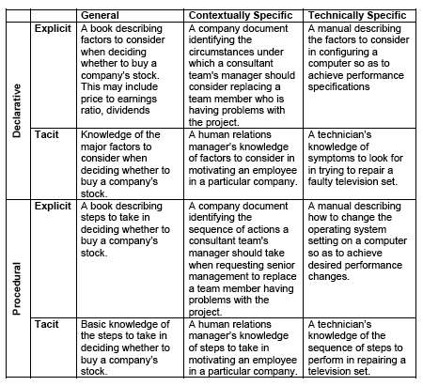
Illustrations of the Different Types of Knowledge

Slide 20
Knowledge and Expertise
Expertise can be defined as knowledge of higher quality
An “expert” is one who is able to perform a task much better than others

Slide 21
Characteristics of Knowledge
Explicitness
Codifiability
Teachability
Knowledge Specificity

Slide 22
Knowledge Management
Knowledge management can be defined as performing the activities involved in discovering, capturing, sharing, and applying knowledge so as to enhance, in a cost-effective fashion, the impact of knowledge on the unit’s goal achievement.

Slide 23
Knowledge Resources
The term knowledge resources refers not only to the knowledge currently possessed by the individual or the organization but also to the knowledge that can potentially be obtained (at some cost if necessary) from other individuals or organizations

Slide 24
Knowledge Management Systems
refer to the use of modern information technologies—the Internet, intranets, extranets, data warehouses—to systematize, enhance, and expedite intraﬁrm and interﬁrm knowledge management.
KMSs are intended to help an organization cope with turnover, rapid change, and downsizing by making the expertise of the organization’s human capital widely accessible.

Slide 25
Knowledge Management Technologies
Technologies that support KM include artificial intelligence (AI) technologies encompassing those used for knowledge acquisition and case-based reasoning systems, electronic discussion groups, computer-based simulations, databases, decision support systems, enterprise resource planning systems, expert systems, management information systems, expertise locator systems, videoconferencing, and information repositories encompassing best practices databases and lessons learned systems

Slide 26
The Knowledge Management System Cycle
Create knowledge. Knowledge is created as people determine new ways of doing things or develop know-how. Sometimes external knowledge is brought in.
Capture knowledge. New knowledge must be identiﬁed as valuable and be represented in a reasonable way
Reﬁne knowledge. New knowledge must be placed in context so that it is actionable.
This is where tacit qualities (human insights) must be captured along with explicit facts.

Slide 27
The Knowledge Management System Cycle
Store knowledge. Useful knowledge must then be stored in a reasonable format in a knowledge repository so that others in the organization can access it.
Manage knowledge. Like a library, the knowledge must be kept current. It must be reviewed regularly to verify that it is relevant and accurate.
Disseminate knowledge. Knowledge must be made available in a useful format to anyone in the organization who needs it, anywhere and anytime

Slide 28
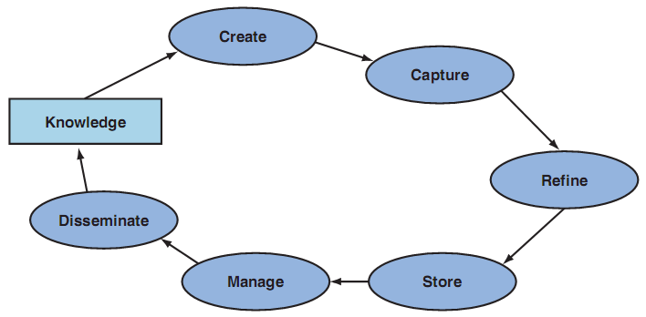

Slide 29
How KM Impacts People
Knowledge
Employee Learning
Knowledge Management
Employee Adaptability
Employee
Job Satisfaction

Slide 30
How KM Impacts Organizational Processes?
Process Effectiveness
Fewer mistakes
Adaptation to changed circumstances
Knowledge Management
Knowledge
Process Efficiency
Productivity improvement
Cost savings
Process Innovation
Improved brainstorming
Better exploitation of new ideas

Slide 31
Impact on Products
Impact on products can be
Value added products
Knowledge based products
Knowledge
Value-added Products
Knowledge-based products
Knowledge Management

Slide 32
How Knowledge Management Impacts Organizational Performance
Organizational Performance
Scale economies
Scope economies
Sustainable competitive advantage
Knowledge
Vision
Strategy
Revenues
Costs
Knowledge Management

Slide 33
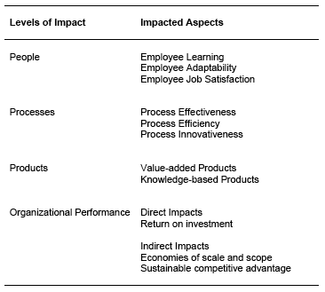
A Summary of Organizational Impacts of Knowledge Management

